Slide 1

I.B. ATTITUDES

Slide 2
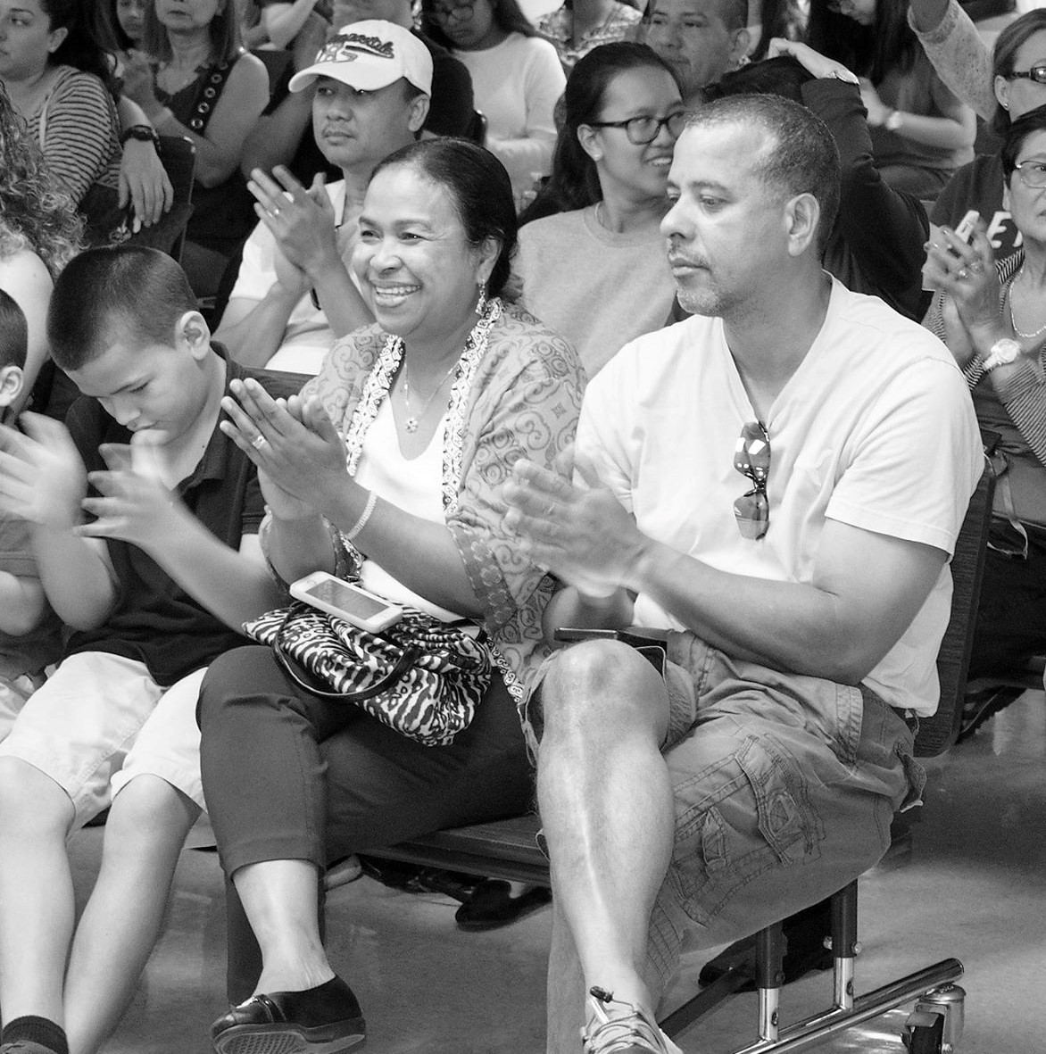
I am thankful

Slide 3
Appreciation

Slide 4
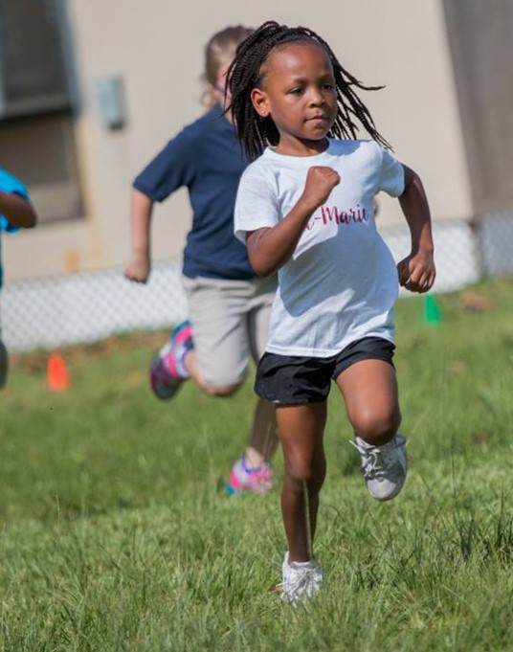
I will not give up!

Slide 5
Commitment

Slide 6
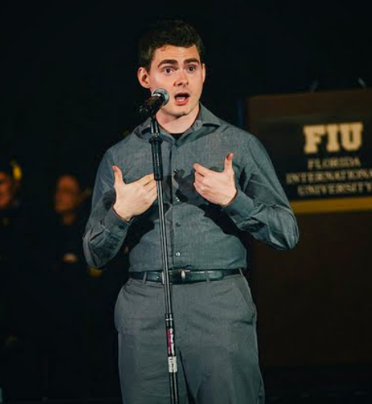
I know I can!

Slide 7
Confidence

Slide 8
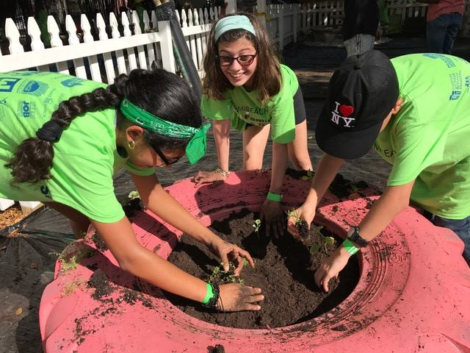
I work with
others!

Slide 9
Cooperation

Slide 10
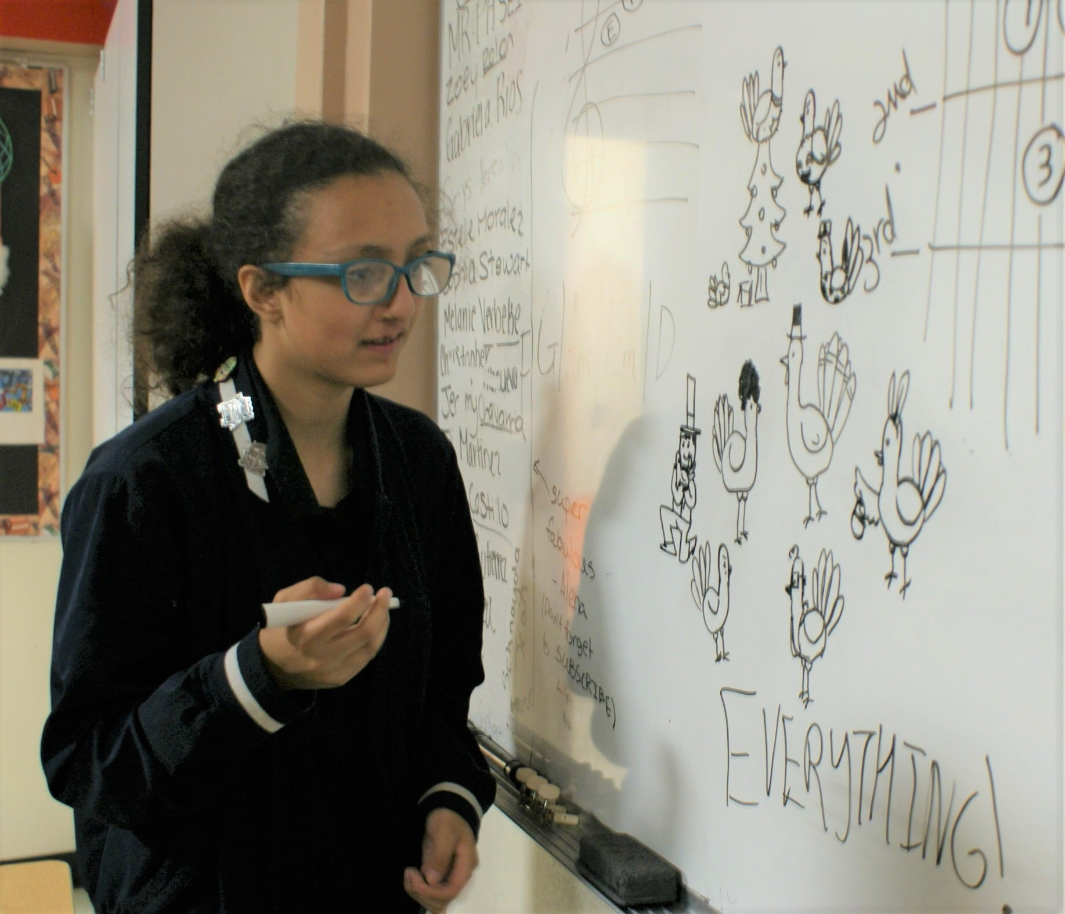
I have an idea!

Slide 11
Creativity

Slide 12
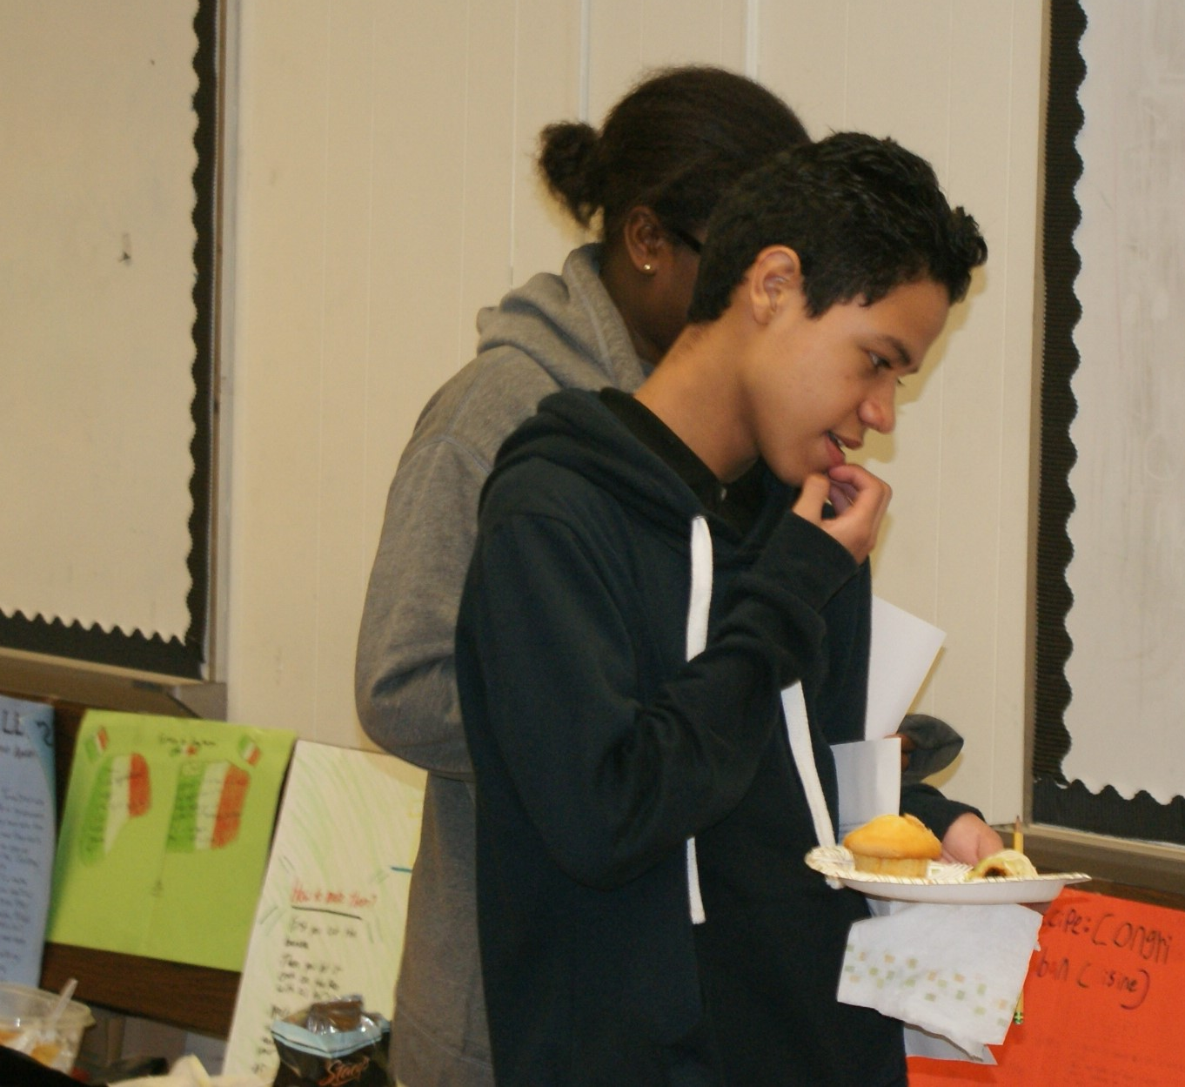
I wonder…

Slide 13
Curiousity

Slide 14
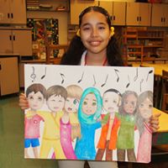
I know how
you feel

Slide 15
Empathy

Slide 16
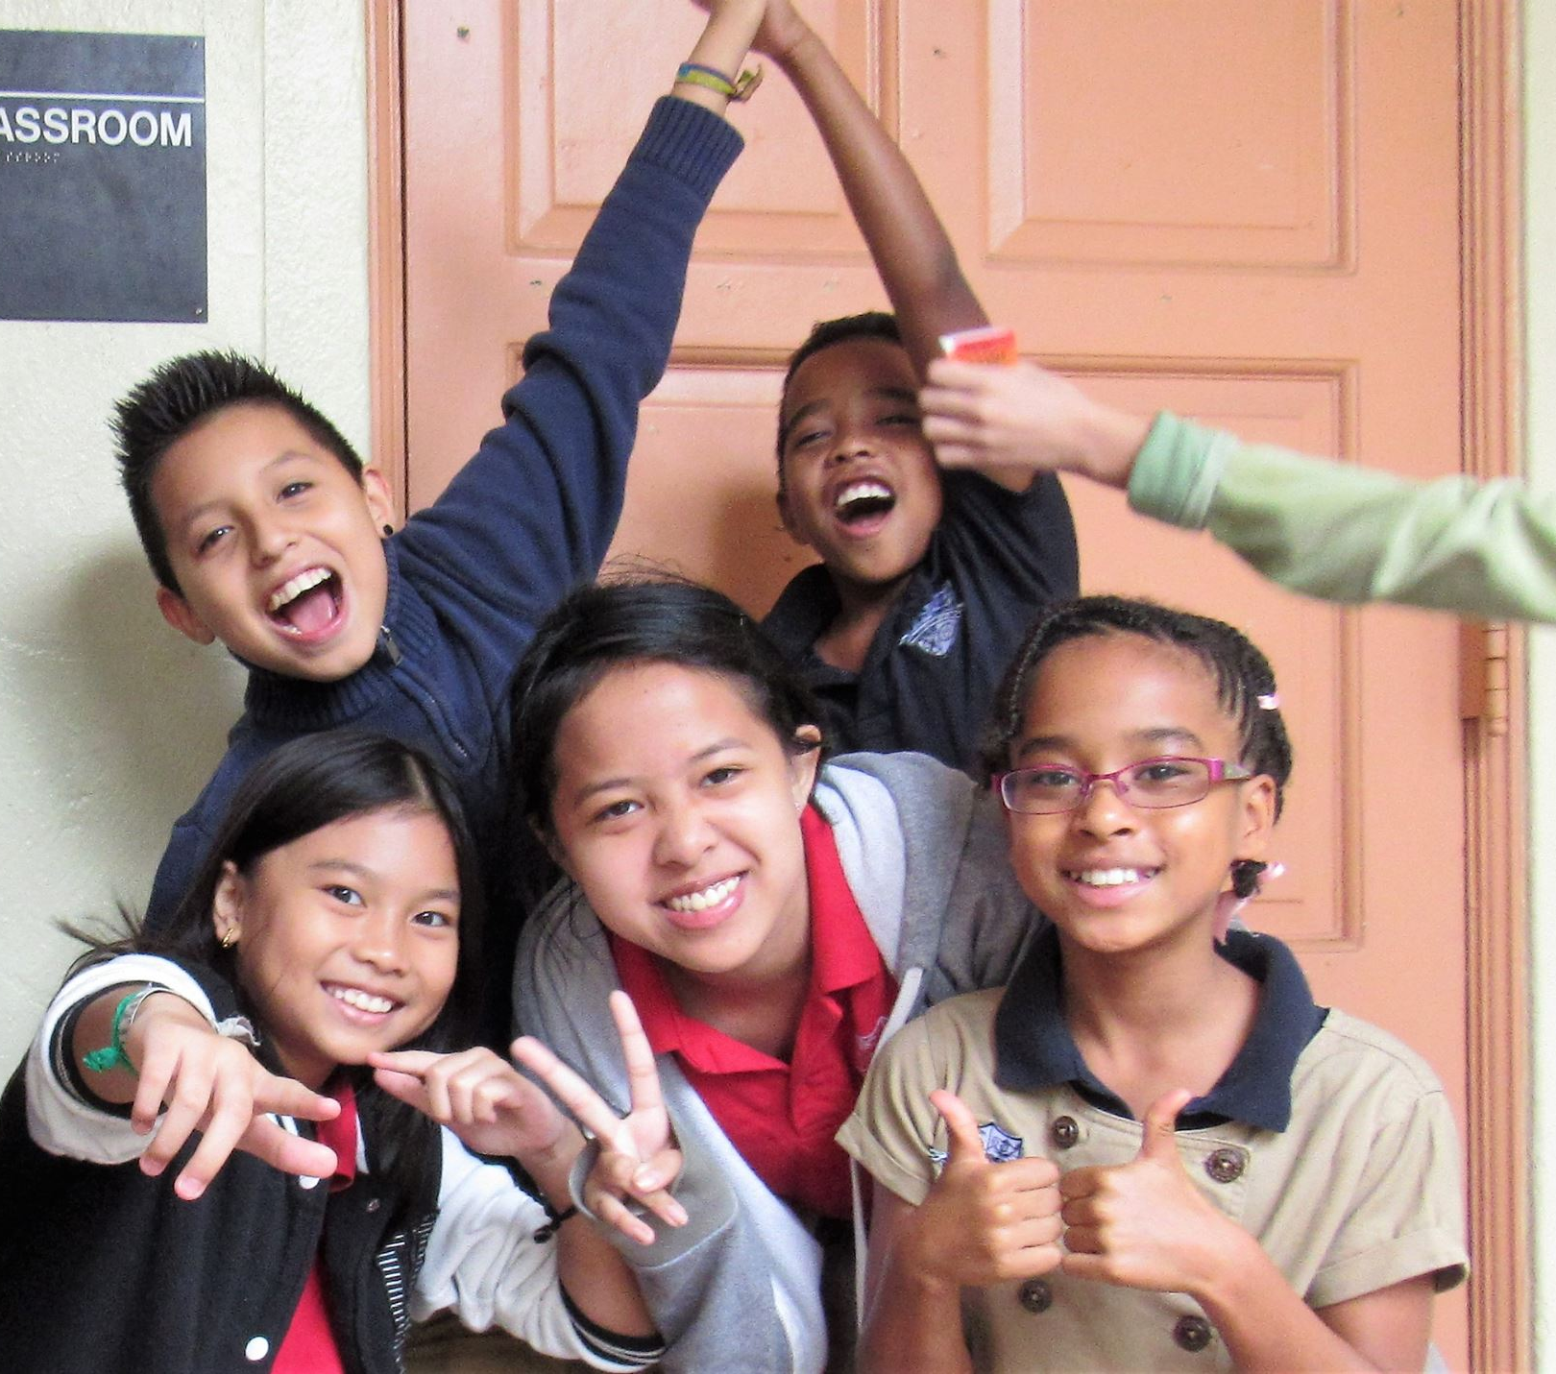
I am excited!

Slide 17
Enthusiasm

Slide 18
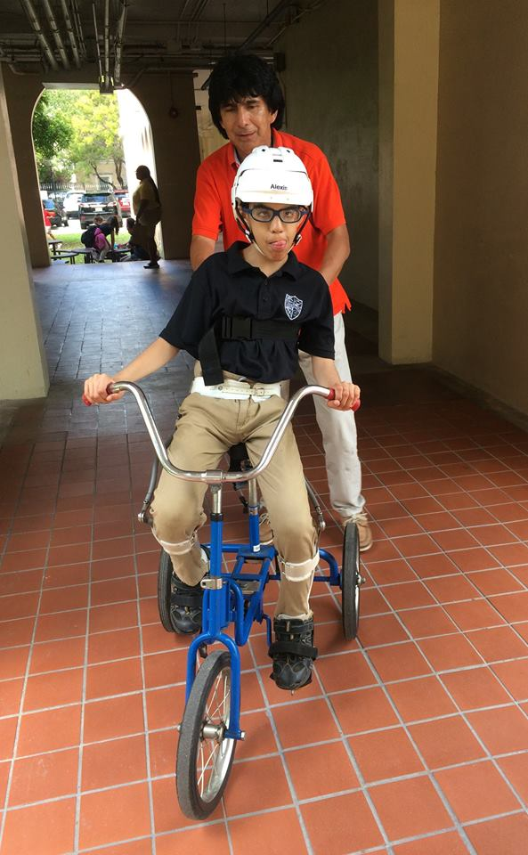
I can do it
by myself

Slide 19
Independence

Slide 20
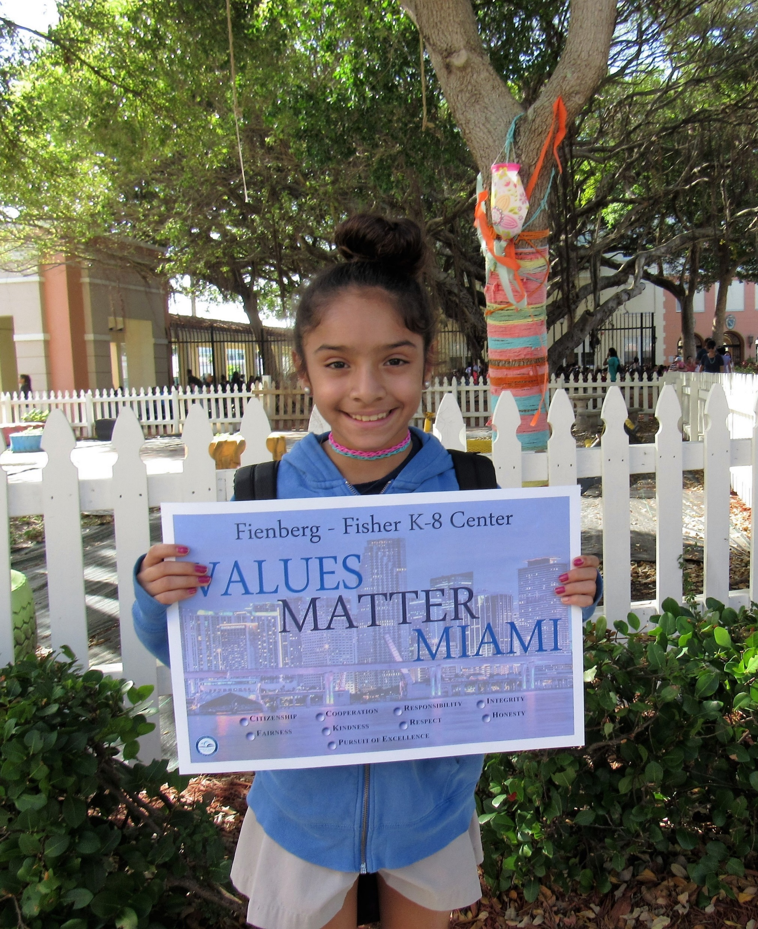
I do the
right thing

Slide 21
Integrity

Slide 22
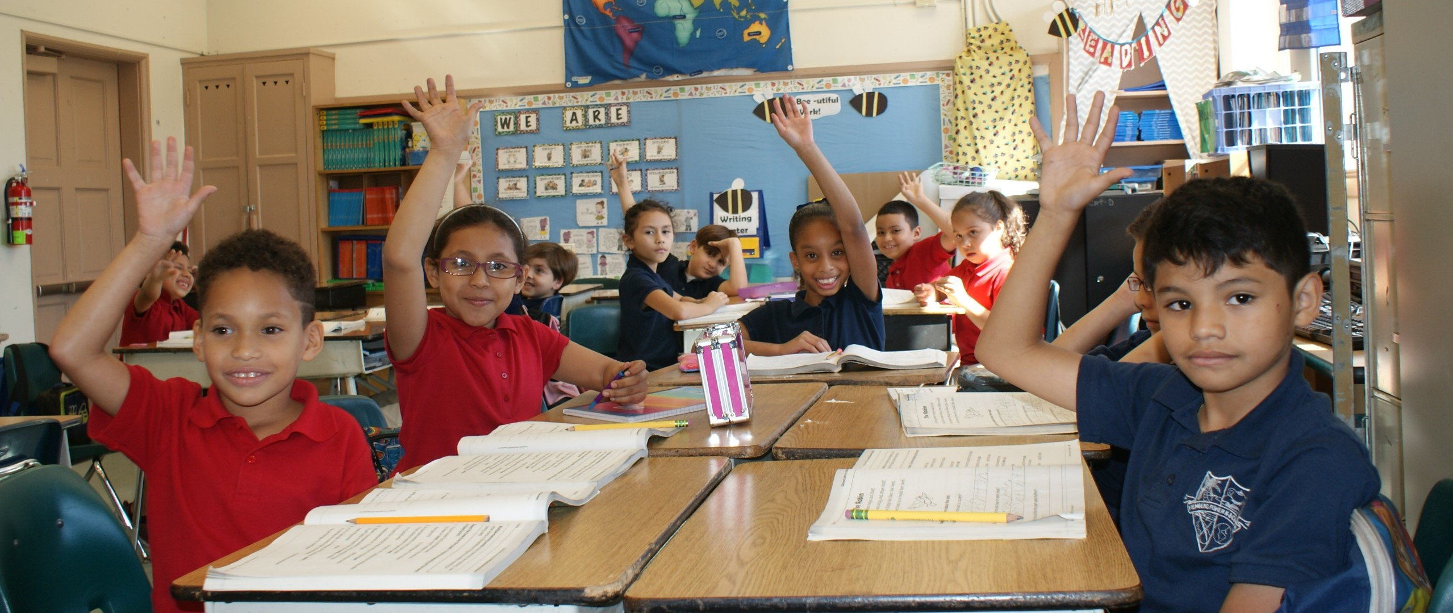
I am polite

Slide 23
Respect

Slide 24
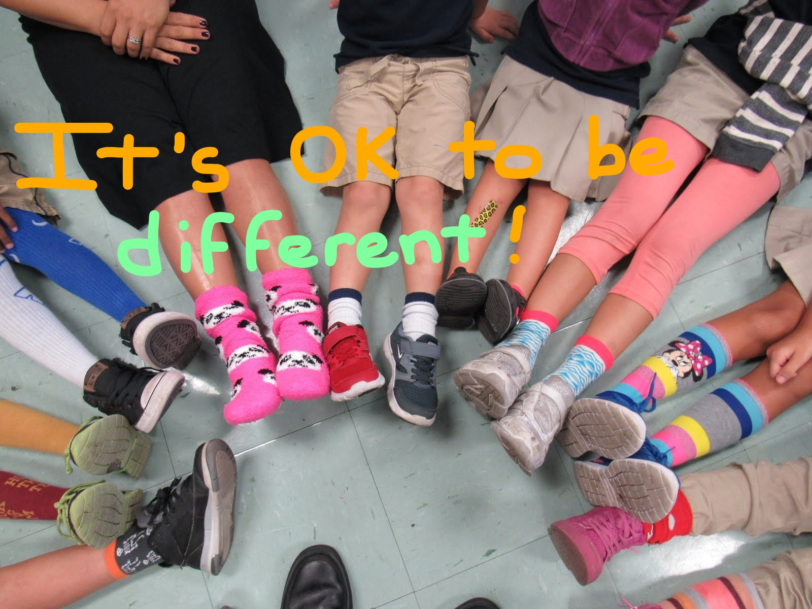
I accept others

Slide 25
Tolerance

